Slide 1


Architect
Project Developer : Zachary Hightower
  zphighto@go.olemiss.edu
Project Sponsor : Jeffrey Lucas
  jhlucas1@olemiss.edu

Slide 2
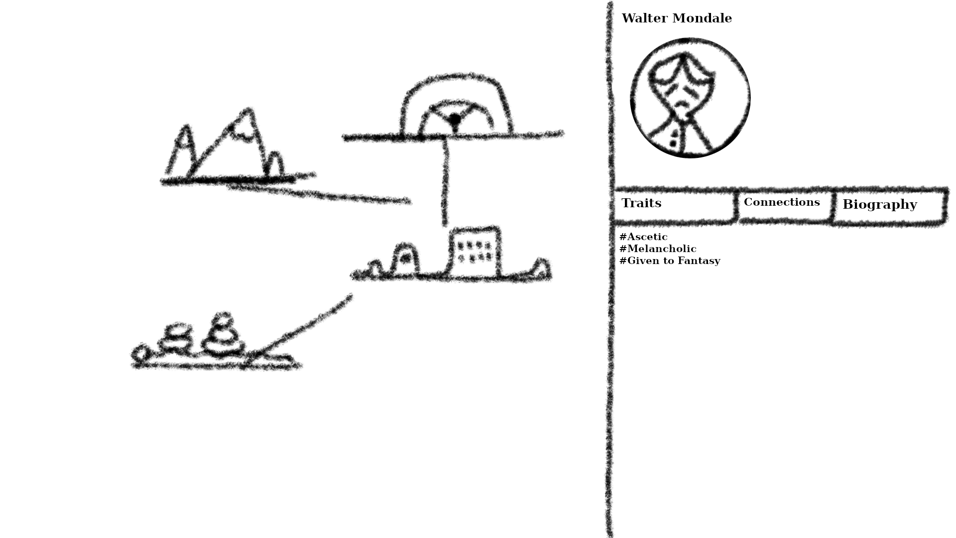

Goals
Give writers an easy to use tool for organizing and visualizing their ideas
Primary Users:
  Authors, game devs, Tabletop RPG players

Slide 3
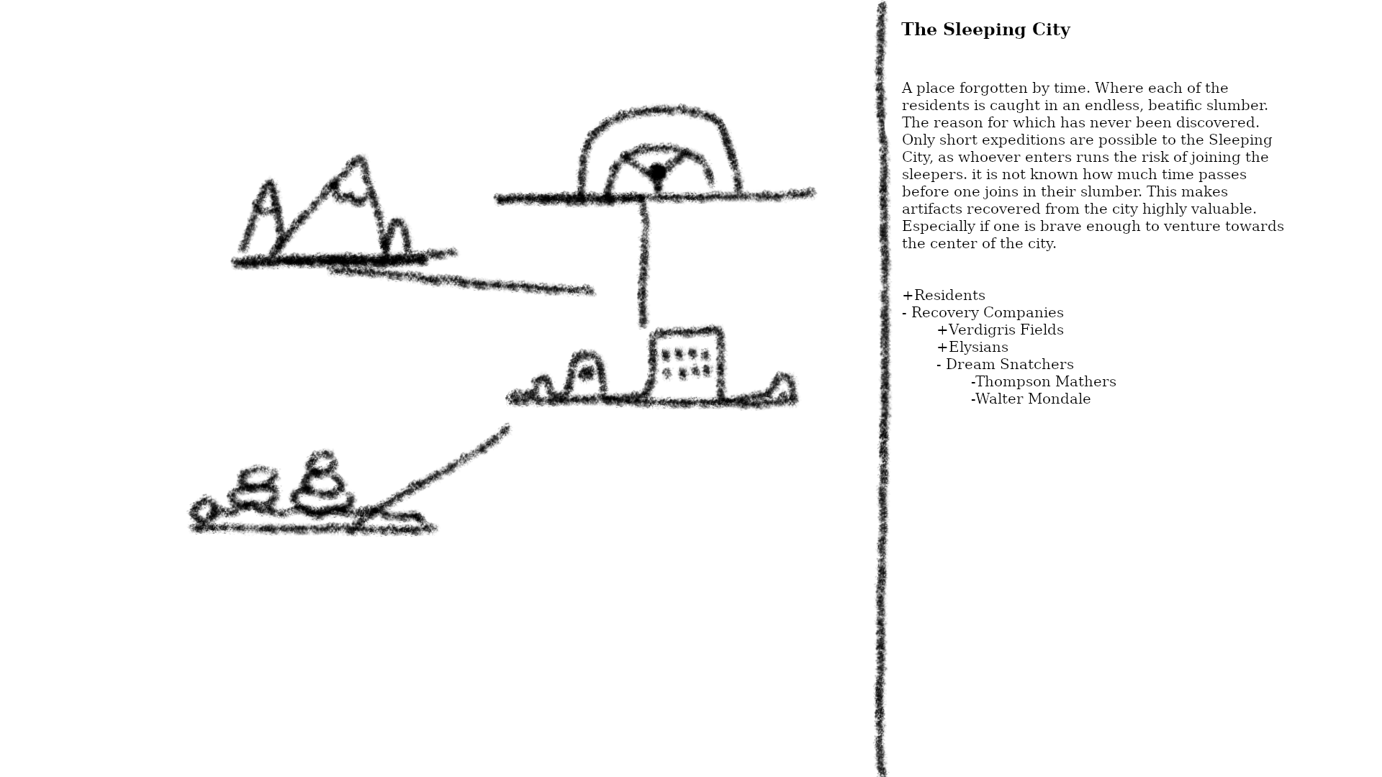
Minimum Viable Product
Map creation w/ customizable locations
Entry system for detailed notes
PDF export for saving and sharing

Slide 4

Tech Evaluation
Frontend:
  HTML, CSS, JavaScript
    Most familiar
    Used in some smaller projects
  Ruby on Rails, React
    Extensive function libraries
    Large community support

Slide 5
Tech Evaluation Cont.
Backend:
PHP
  Familiarity from other coursework
  Works well with relational databases
Node.js
  Large libraries w/ lots of tools
  Good for I/O heavy projects

Slide 6
Tech Evaluation Cont.
Database:
  MySQL
    Structured system, used in prior projects
    Suited for complex querying
  Firebase, MongoDB
    Highly flexible system
    Ability to handle unstructured data

Slide 7
Final Project Selections
Frontend: HTML, CSS, JavaScript
Backend: PHP
Database: MySQL
Testing Tools: Jest for unit testing, Selenium for end-to-end testing
Deployment Environment:Turing server

Slide 8
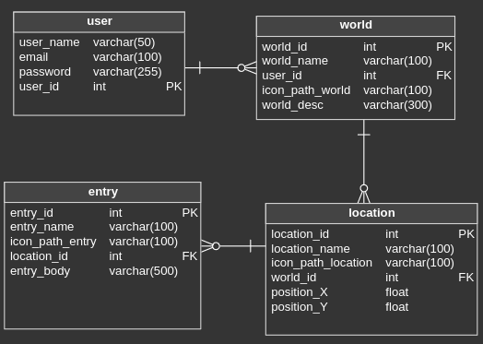
Database Design

Slide 9
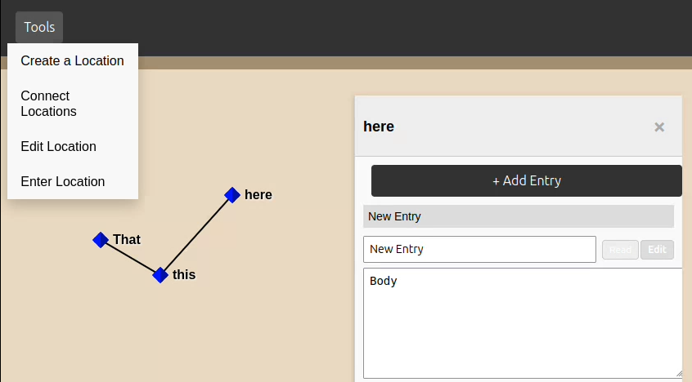
UI Design
Insert according to slide outline here

Slide 10
Project Demo
Please wait a few moments for a short demonstration of the project.

Slide 11
Q&A
Ready to answer any questions about the project and its development

